Slide 1

Welcome to
Redefine Possible
International Women’s Day 2025

Slide 2
9:00 AM - Registration
10:00 AM - IWD 2025 Opening Ceremony
Yevgeniya Bikmurzina - Head of Innovation ecosystem department @ IDDA - Keynote [AZ]
10:30 AM - Fidan Rustamli
Career Paths in the Gaming Industry: Strategies and Advice [AZ]
11:00 AM - Sevil Shahbandayeva
Fault Tolerance in Microservices: How Circuit Breaker Design Can Save the Day [AZ]
11:30 AM - Marina Ibrahimova
Are We Just Repackaging ChatGPT? [ENG]
12:00 PM - Rahima Mammadova
Hacking Humans: The power of social engineering in cybersecurity[AZ]
12:30 PM - Gunay Azer
No Investment to Market Leader: How I Scaled Without Investors[ENG]
1:00 PM - Break : Coffee Break
2:00 PM - Gunay Ibrahimova
İT-nin ürəyində UX: Texnologiyanı necə hər kəsin dostuna çeviririk?[AZ]
2:30 PM - Khayala Mammadova
Design & Develop Decentralized Application (dApps)[ENG]
3:00 PM - Shabnam Baghirzada
Sosial Media Strategiyası və Rəqəmsal Kommunikasiya[AZ]
3:30 PM - Sifaya Akbarova
4:00 PM - Certificate ceremony
Certificate and Closing Ceremony
Agenda

Slide 3

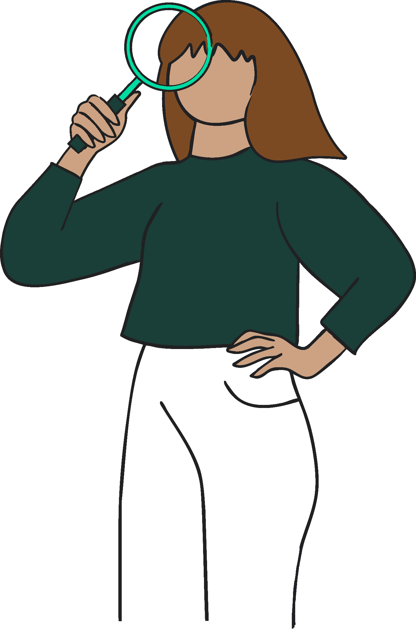
Proprietary and Confidential
01
About Women Techmakers and International Women’s Day

Slide 4
What is Women Techmakers International Women’s Day?
International Women’s Day (IWD) is Women Techmakers’ largest annual campaign where Ambassador host and speak at events all around the world during the months of March and April in celebration of this moment.
From big summits to smaller gatherings, IWD is a time to host and speak at events that create connections, educate and inspire your tech community.
IWD is also a way in which we support our mission of building a world where all women thrive in tech.
In 2024 our “Impact the Future” IWD campaign reached over 200k+ attendees worldwide!!
Globally, International Women’s Day (IWD) occurs on March 8th every year. It marks a moment to celebrate and provide visibility for the incredible contributions of women around the world and is a call to action for accelerating gender parity.

Slide 5

Proprietary and Confidential
02
Getting
started

Slide 6

Theme & Brand Guide
The International Women's Day theme serves as a powerful catalyst, uniting Women Techmakers events across the globe in a shared vision. Through this common thread, we amplify our collective voice and create a worldwide movement that drives meaningful change for women in technology. Our comprehensive Brand Guide brings this vision to life, providing Ambassadors with customizable assets and creative tools to promote to their communities and create compelling events that resonate across cultures and borders.
The future of technology is something we actively shape, and what seems impossible today becomes possible when we dare to challenge it. How will you "Redefine Possible" this International Women's Day?
2025 IWD Theme: Redefine Possible
IWD hashtag: #WTMIWD, #WTMRedefinePossible
#WTMBaku , #WTMIWDBaku #GDGBaku

Slide 7
About the theme: Redefine Possible
"Redefine Possible" is a bold declaration that challenges the boundaries of what technology can achieve and reimagines who shapes its future.
We stand at a pivotal moment where AI is transforming our world—bringing unprecedented opportunities but also risking the amplification of gender biases and systemic barriers. As artificial intelligence becomes woven into society, we believe that women are not just participating in its development—they're revolutionizing it, breaking conventions, and expanding the horizons of what technology can and should be.
The future of technology isn't predetermined— it is something we actively shape. What seems impossible today becomes tomorrow’s reality when we dare to challenge it.
Notes:
Highlight the urgency: We're at a critical point where AI is reshaping society.
Emphasize the role of women: Women are not just participating in tech; they're revolutionizing it.
Focus on action: Challenge the audience to think about how they can contribute to redefining possible.
Inspire and empower: Encourage everyone to challenge the status quo and create a more inclusive tech future.

Slide 8
About the theme: Redefine Possible
What does it mean?
🚀 Breaking old rules about what's possible in technology and creating new paths forward
💪 Putting women in the driver's seat of technology's future, not just along for the ride
🌟 Bringing different viewpoints together to create better technology for everyone
⚡ Turning big ideas into real change, one step at a time
🎯 Building technology that helps everyone and thinks about tomorrow, not just today
🌐 Taking control of technology's future instead of waiting for others to shape it
Questions for you to consider:
What assumption about women in technology do you most want to challenge?
What barriers have you faced that seemed "impossible" to overcome, and how did you do it?
What's your "impossible dream" for technology's future?
How can we ensure AI development reflects diverse perspectives and experiences?
How can we ensure the next generation of women in tech starts from "possible" rather than fighting "impossible"?

Slide 9
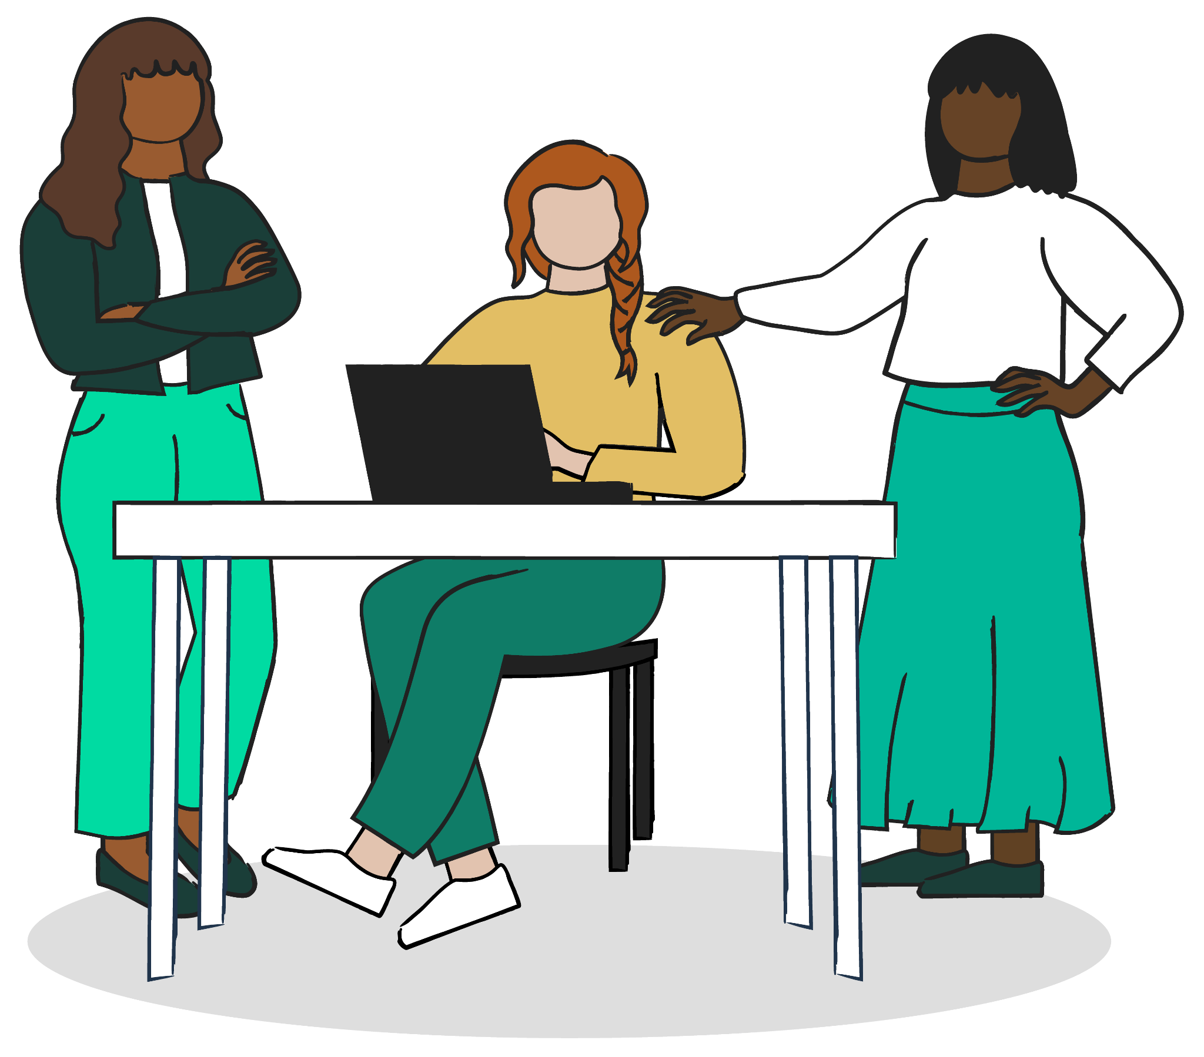
Proprietary and Confidential
03
Event planning

Slide 10
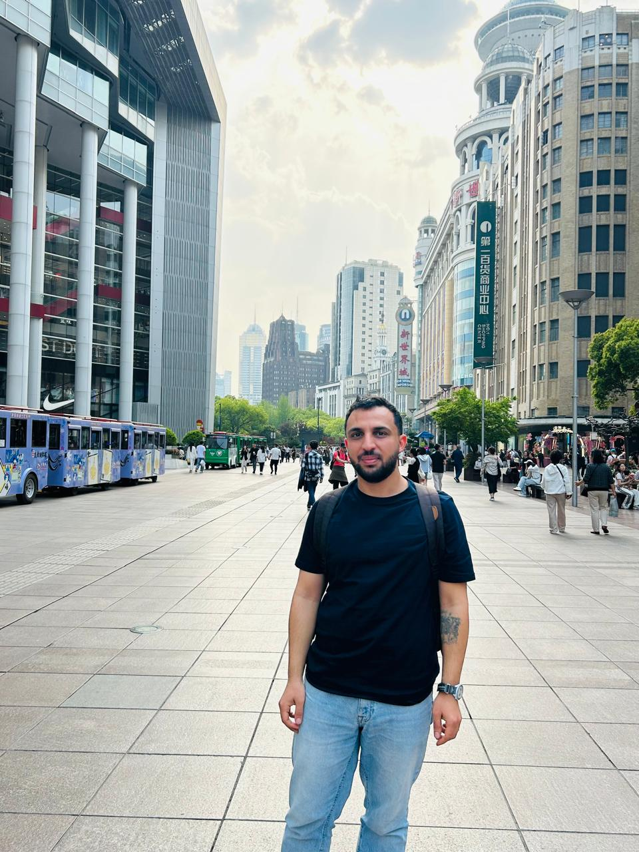
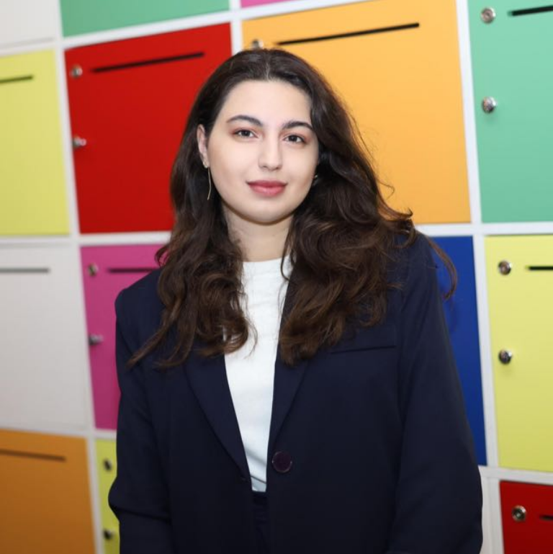
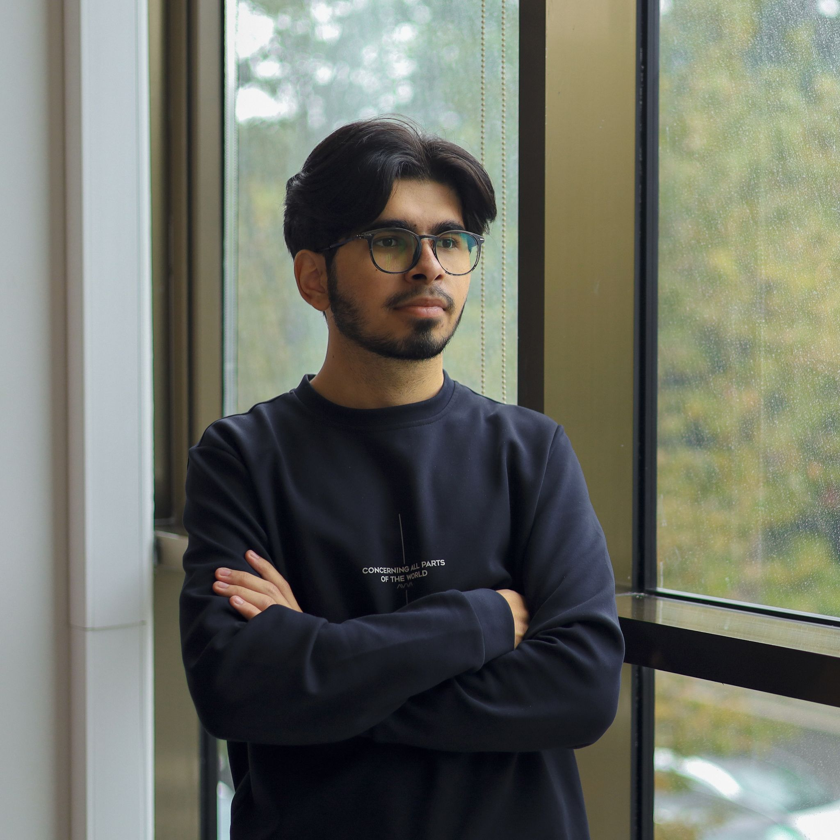
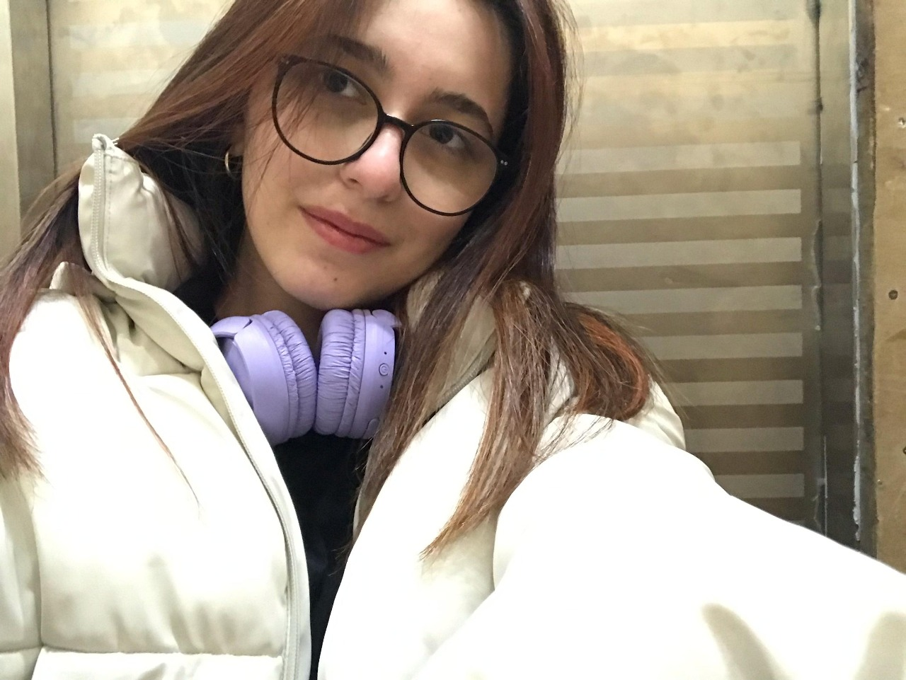
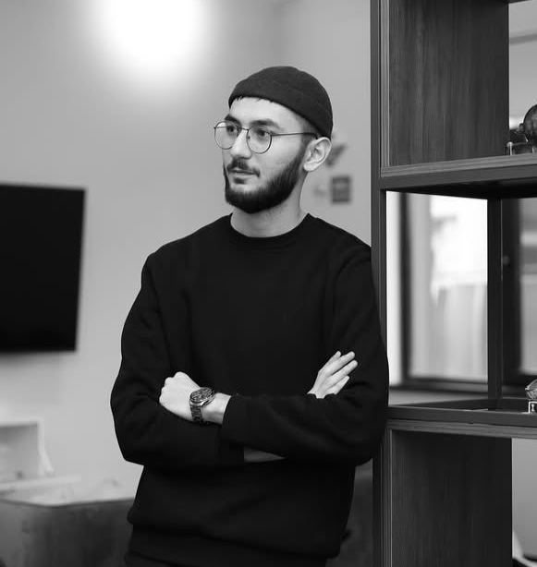
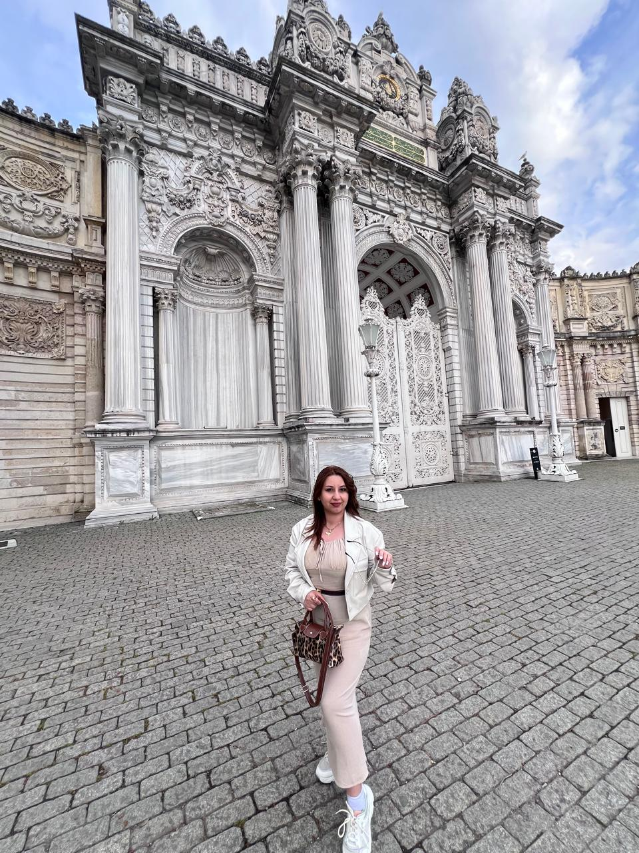
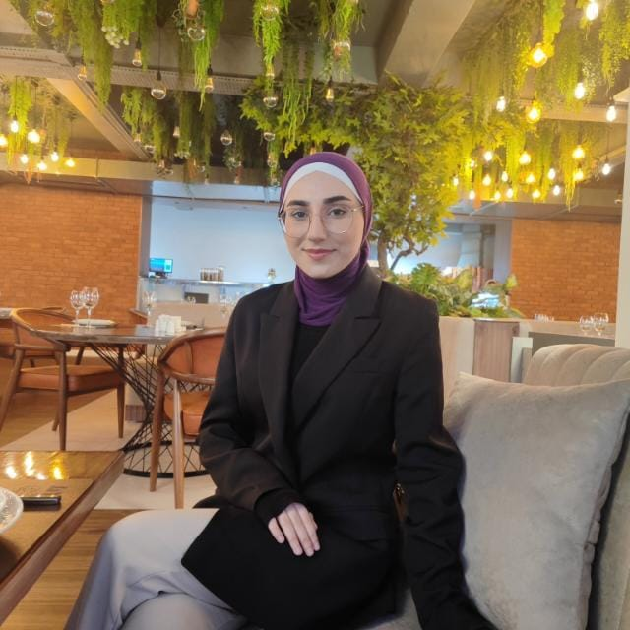
IWD 2025 Organizers

Slide 11
IWD 2025 Key Dates
Dec 12/13
Deep Dive Global Calls with WTM Ambassadors
January →
We see the Brand Guide of 2025
Online meetings for event
April 19
We are here :)
December 2024 January 2025 February 2025
March - April 2025
January →
IWD Budget requests
February
IWD budget requests
February - March
Searching Venue
Mid-March
Searching IWD event speakers

Slide 12
✍️
Determine event plan
👥
Building team
🚀
Promote your event
🏢
Find a venue
🤝
Engage your audience
🏆
Follow inclusive best practices
🗓️
Create project plan & timeline
📃
Code of Conduct
🎬
Determine agenda
📝
Finalize content & create deck
🎤
Request speakers
🚨
Determine backup plans
💰
Request Budget
✅
Create registration page

Slide 13
Women Techmakers Code of Conduct
Be respectful to each other
Treat everyone with respect. Participate while acknowledging that everyone deserves to be here — and each of us has the right to enjoy our experience without fear of harassment, discrimination, or condescension, whether blatant or via micro-aggressions. All forms of communication should not demean others. Consider what you are saying and how it would feel if it were said to you, or about you.
Speak up if you see or hear something
Harassment is not tolerated, and you are empowered to politely engage when you or others are disrespected. The person making you feel uncomfortable may not be aware of what they are doing, and politely bringing their behavior to their attention is encouraged.
ZERO TOLERANCE POLICY for in-person or online harassment of any kind
including but not limited to:
-Deliberate intimidation
-Harassing photography or recording
-Sustained disruption of talks or other events
-Offensive verbal language
-Verbal language that reinforces social structures of domination
-Sexual imagery and language
-Unwelcome sexual or physical attention
-Physical or cyber threats

Slide 14
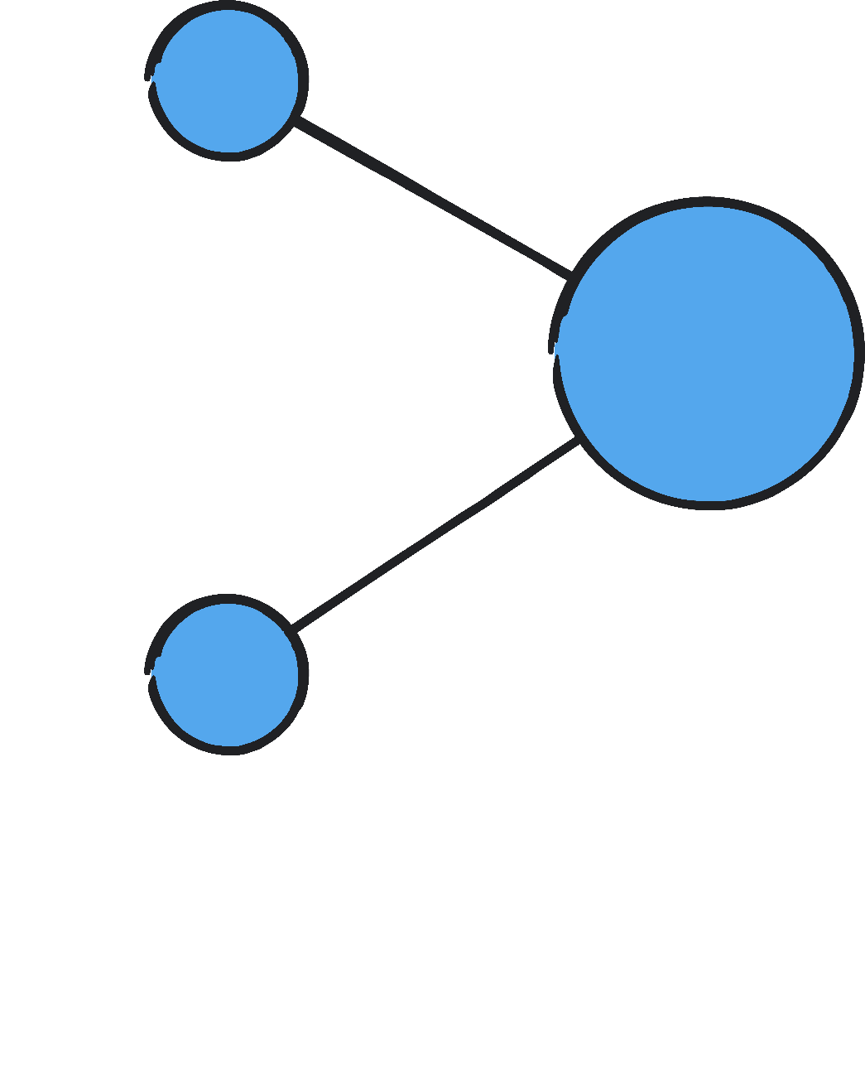

Proprietary and Confidential
04
Our IWD Speakers

Slide 15
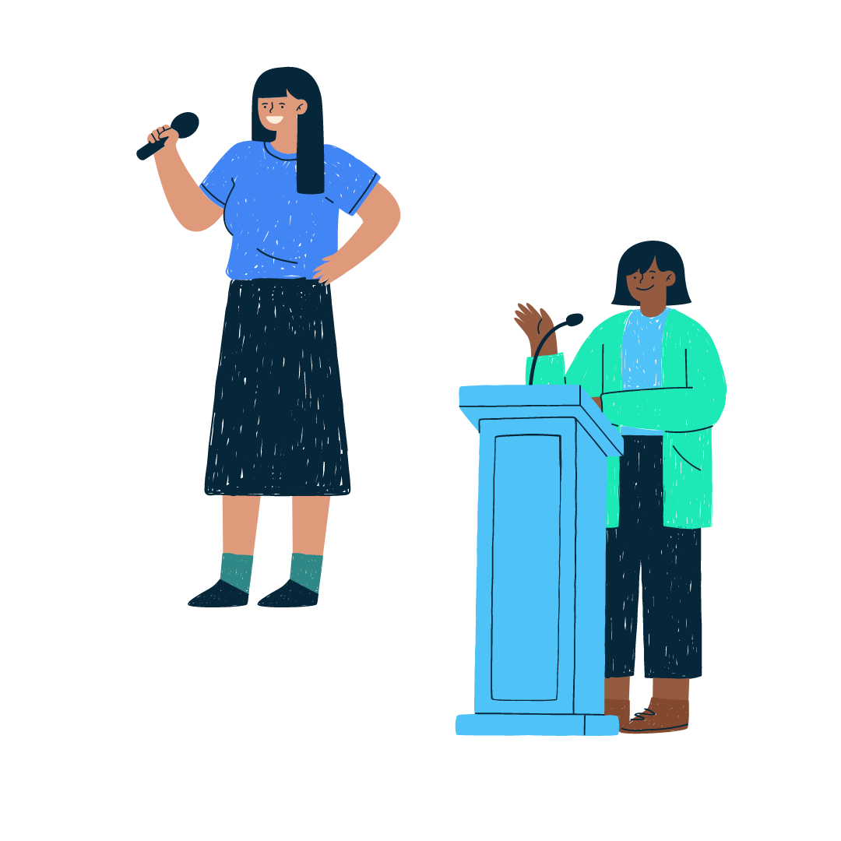


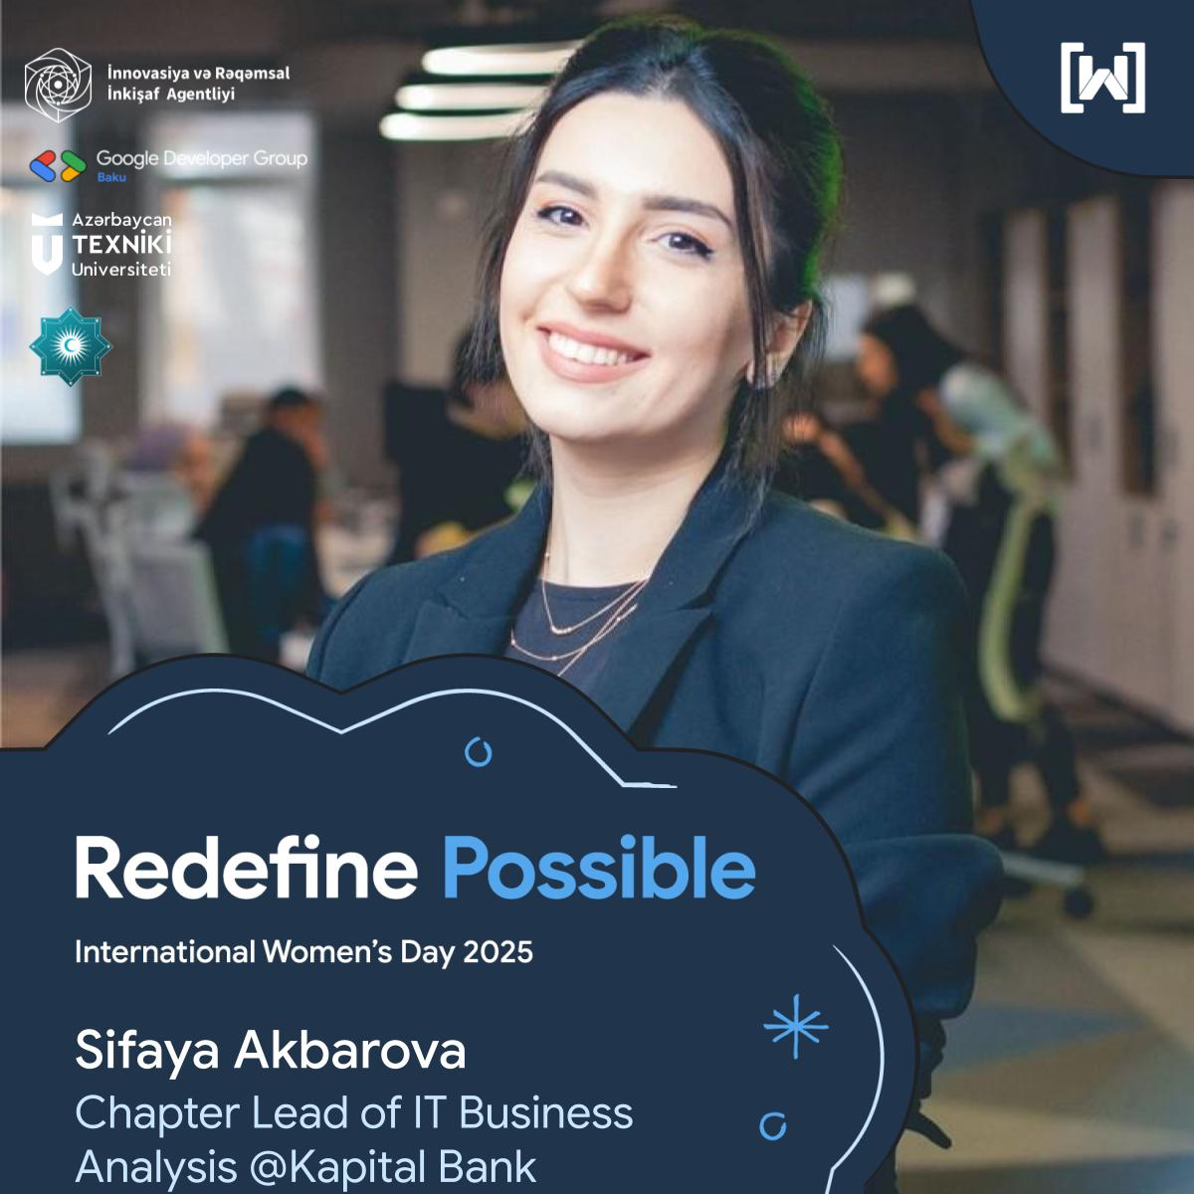



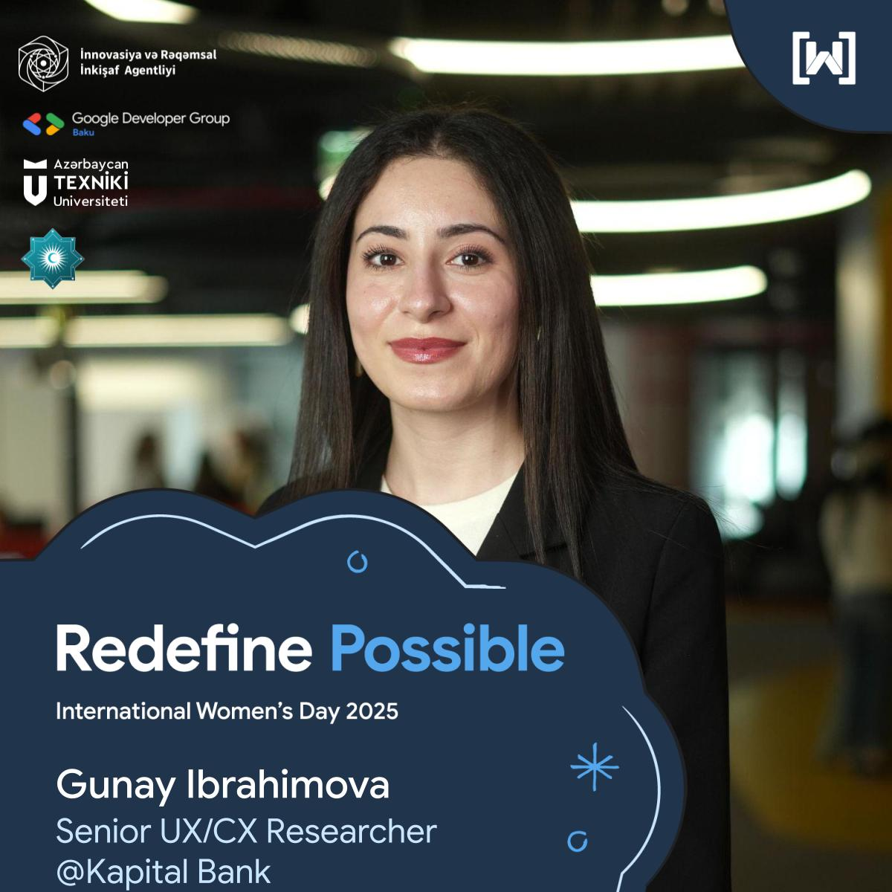


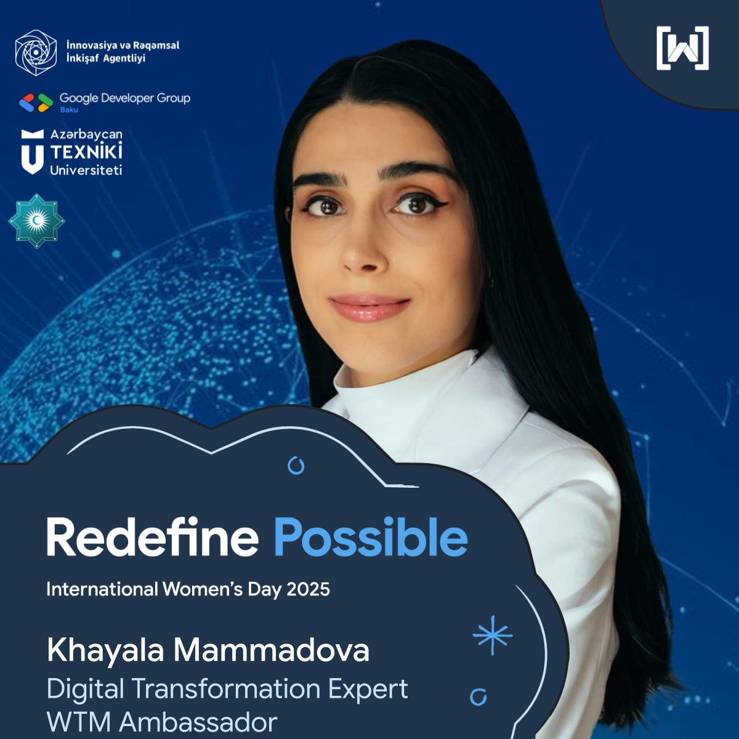

Slide 16
Proprietary and Confidential
Thank you for joining us :)

Slide 17
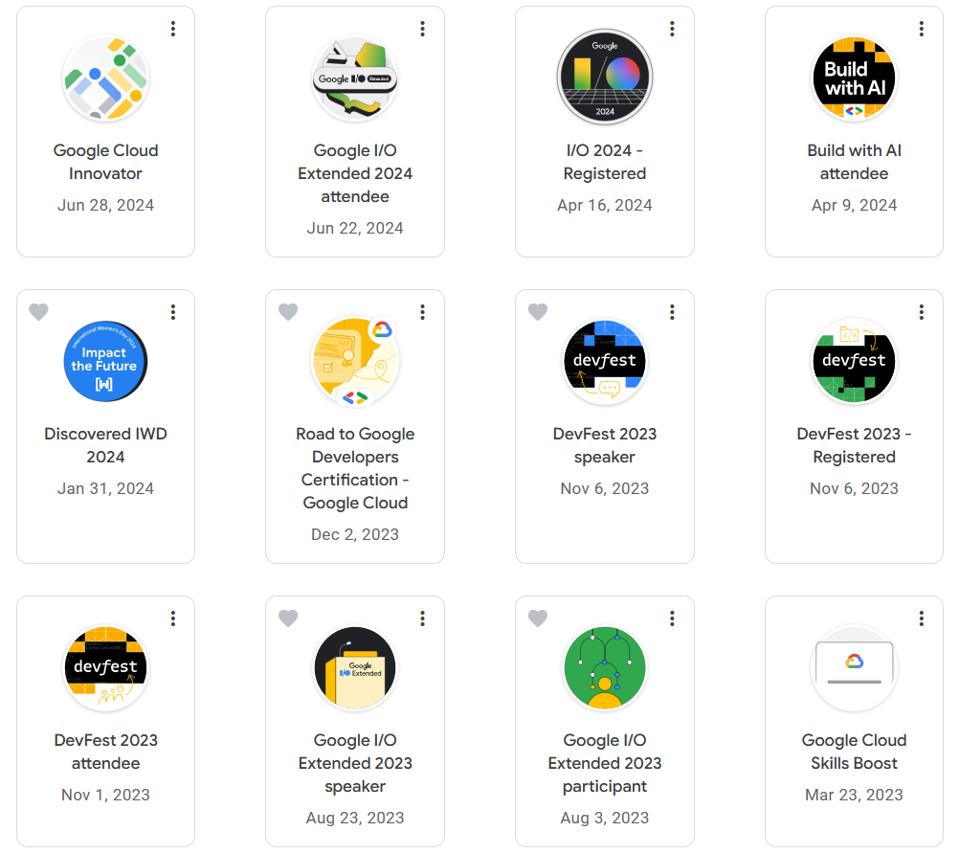
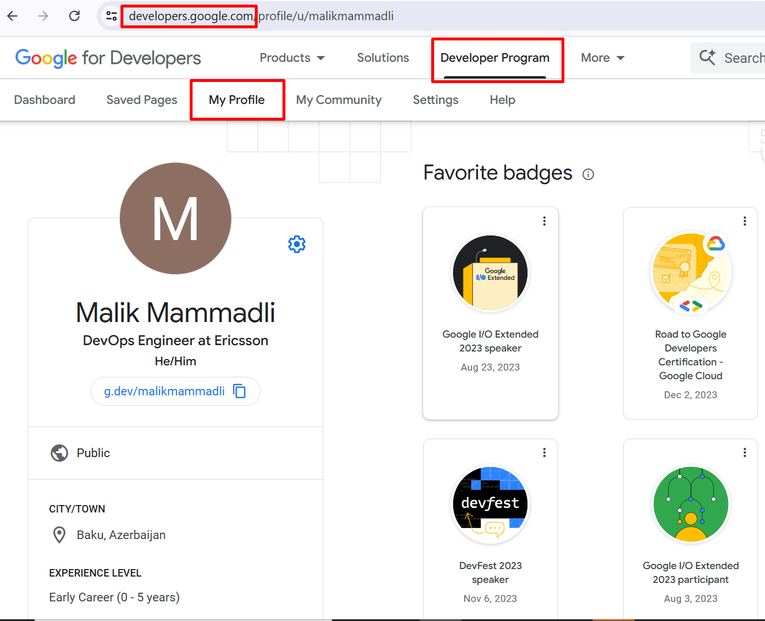
Google Developer profile

Slide 18
Baku
What’s next !

Slide 19
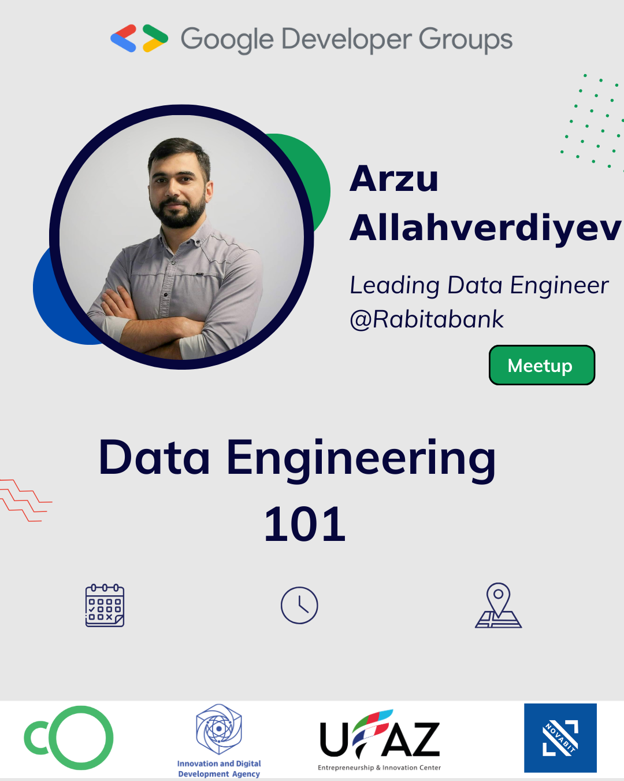
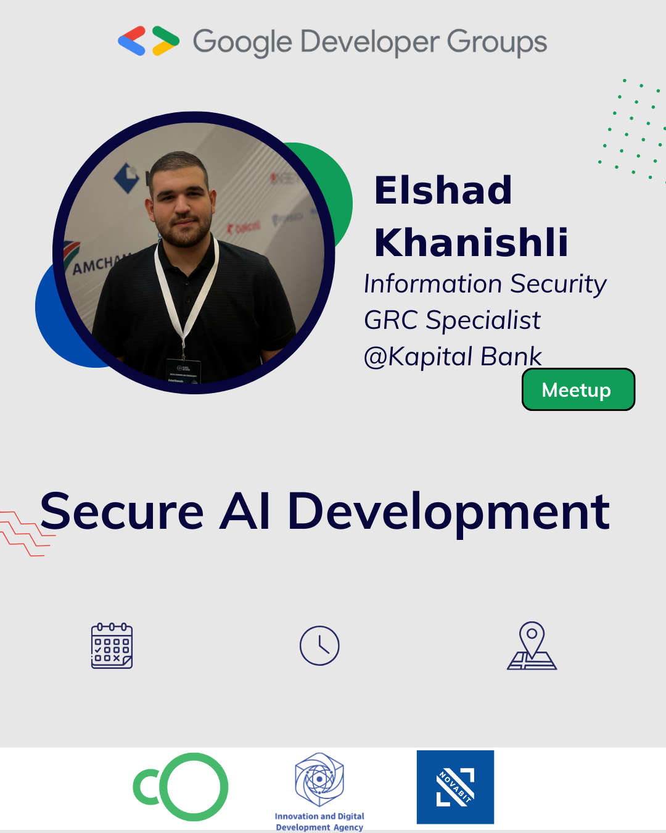



AI App Development
5 weeks cloud bootcamp(free)

Slide 20


Slide 21


Proprietary and Confidential
05
Badge :)

Slide 22

https://shorturl.at/yl3Mi

Slide 23
Proprietary and Confidential
Thank you for joining us :)

